Slide 1
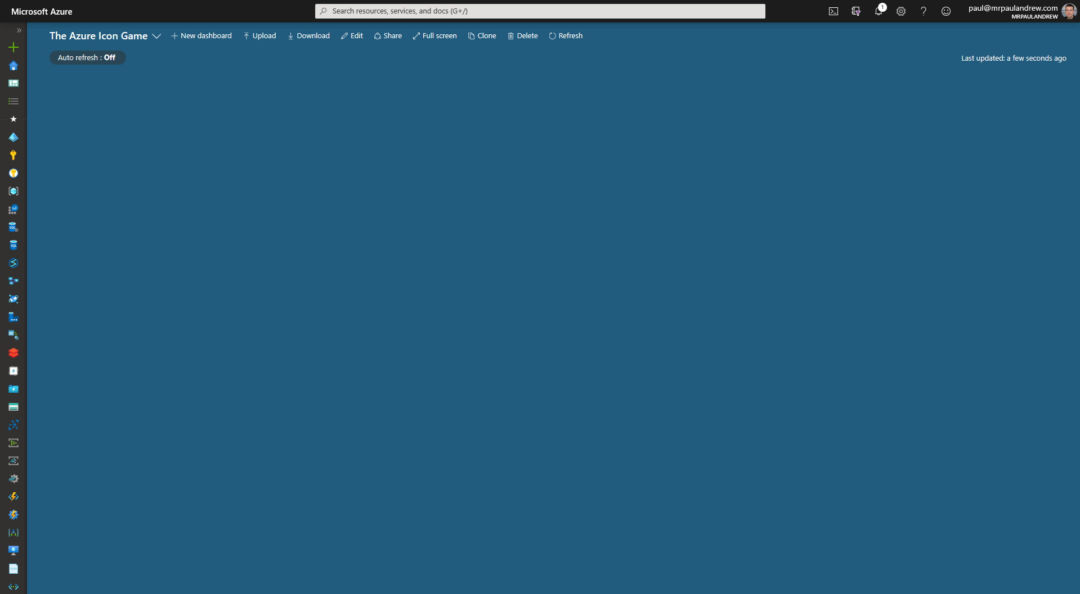
?
?
?
?
?
The Azure Icon Game

Slide 2
Microsoft Azure

Slide 3

Users

Slide 4

SQL Database

Slide 5

SQL Logical Instance

Slide 6

PostgreSQL

Slide 7

MySQL

Slide 8

Virtual Machine

Slide 9

Cosmos DB

Slide 10

Azure Active Directory

Slide 11

Kubernetes

Slide 12

Blockchain

Slide 13

Resource Group

Slide 14

Virtual Network

Slide 15

Network Interface

Slide 16

Express Route

Slide 17

Cognitive Services

Slide 18
Databricks

Slide 19

Redis Cache

Slide 20

Machine Learning

Slide 21

Storage Account

Slide 22

Data Lake Store (Gen1)

Slide 23

Synapse Analytics

Slide 24

Data Factory

Slide 25

Bot Services

Slide 26

Automation

Slide 27

Functions

Slide 28

Logic Apps

Slide 29

Analysis Services

Slide 30

Event Grid

Slide 31

Event Hub

Slide 32

Stream Analytics

Slide 33

Power Platform

Slide 34

App Services

Slide 35

Log Analytics

Slide 36

Data Box

Slide 37

Data Explorer

Slide 38

Data Catalog

Slide 39

Key Vault

Slide 40
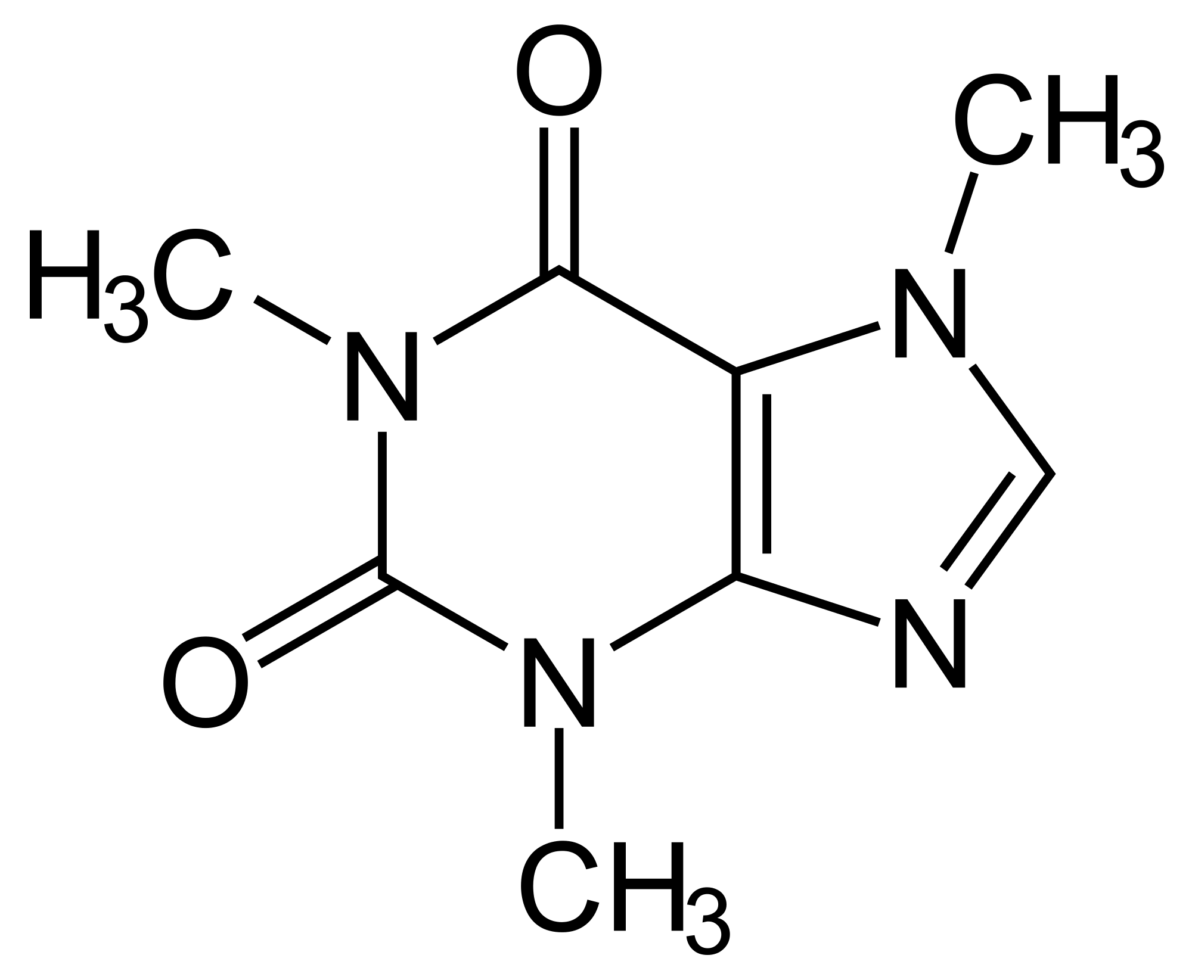
Caffeine

Slide 41
?
?
?
?
?
The Azure Icon Game

Slide 42
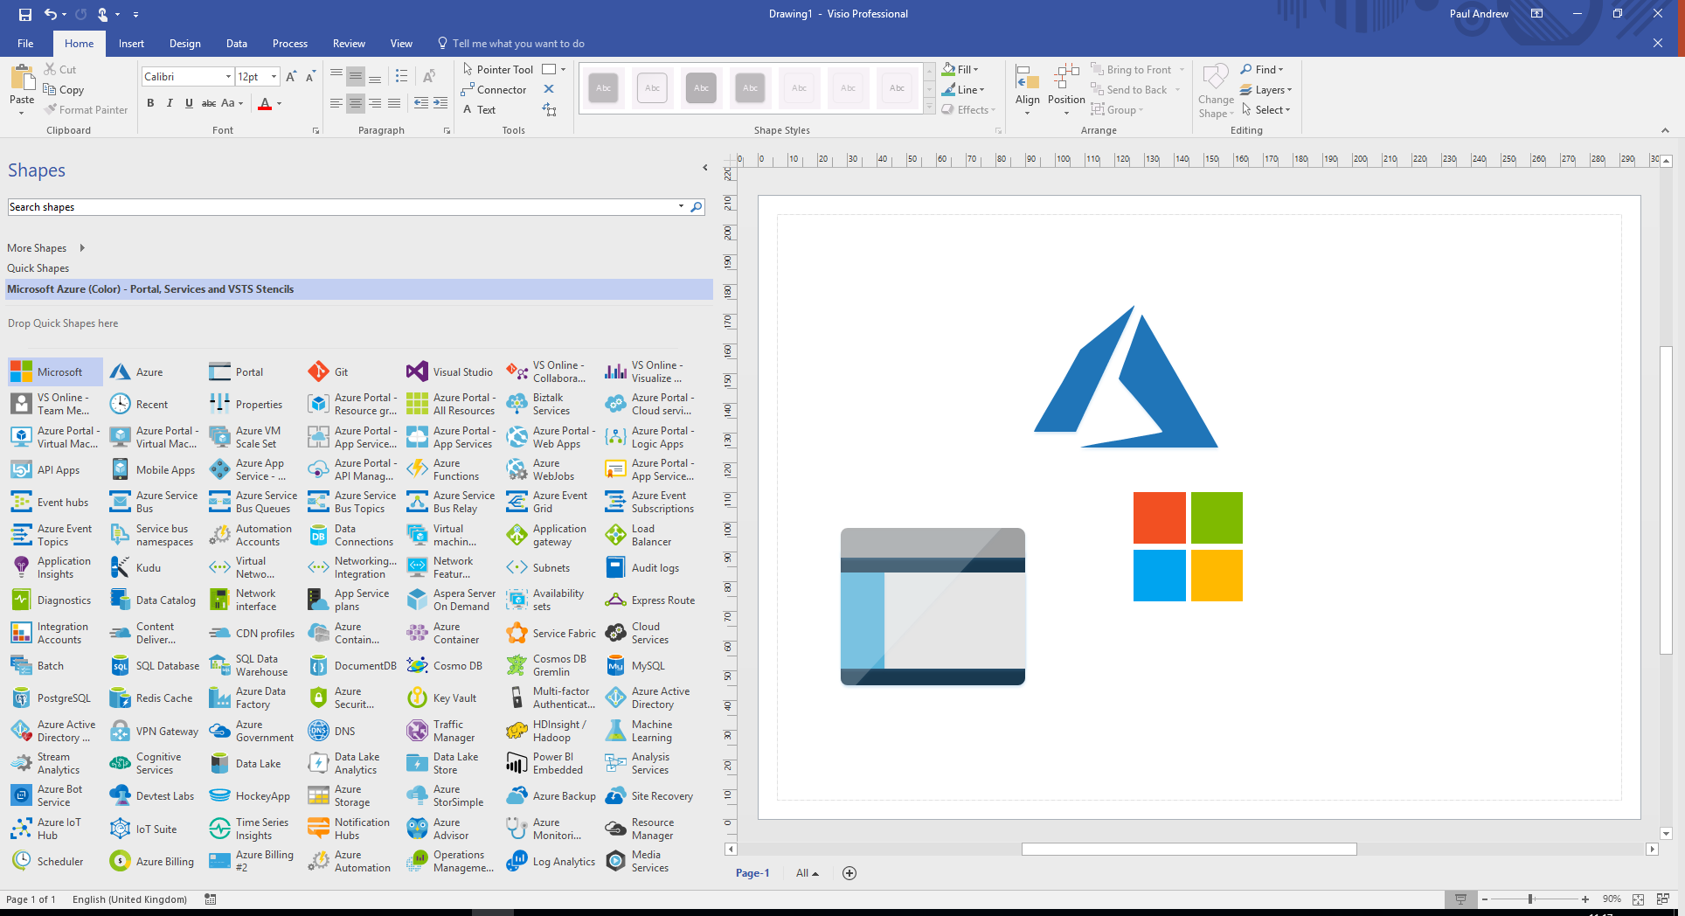
Old Icons
https://www.microsoft.com/en-gb/download/details.aspx?id=41937
https://github.com/mrpaulandrew/ContentCollateral

